Slide 1

DHCPv4 & NAT
CSE 421 – Computer Netwroks
Department of Computer Science and Engineering School of Data & Science

Slide 2
Automatic IP Address Assignment
IP Addressing Services
Address Translation

Slide 3
Objectives
DHCPv4 Concepts
DHCPv4 Operations
NAT Concepts
Introduction to NAT
PAT (NAT Overloading)
Port Forwarding
How devices get IP addresses automatically
How many devices share one IP
address

Slide 4
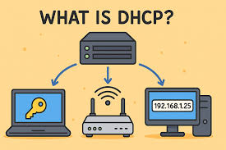
Dynamic Host Configuration Protocol (DHCP)

Slide 5
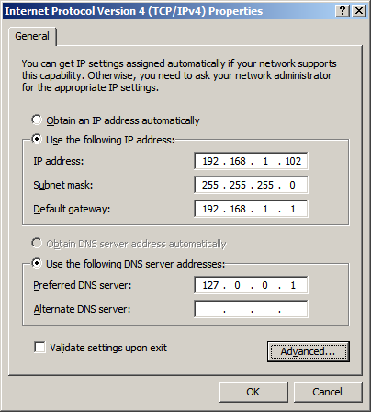
Assigning IPv4 Addresses : Static
Every device that connects to a network needs an IP address.
How to assign an IP address to a device?
Static
Dynamic
Static :
manually assigning ; stays fixed
used for devices must always be reachable
Used for: Web servers, Routers, printers etc.

Slide 6
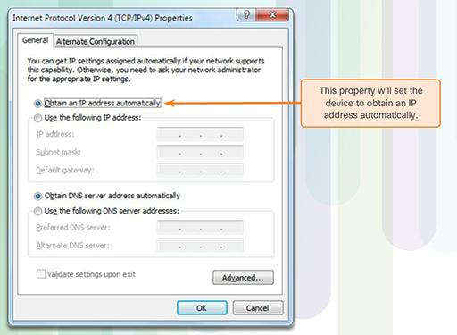
Dynamic IPv4 Addressing
Dynamic :
assigns IP addresses automatically to devices.
Used for : Laptops,phones, moving devices
Who does this??
DHCP
Dynamic Host Configuration Protocol

Slide 7
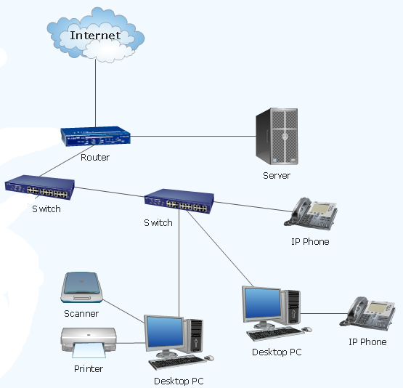
Static Assignments?
Dynamic Assignments?

Slide 8


Dynamic Host Configuration Protocol (DHCP)
Which device runs it?
Used in large organizations
More scalable.
Easier to manage many clients
Usually part of a central server (Windows Server, Linux DHCP, etc.)
Servers
Common in homes, small offices (SOHO)
Cheaper
Simple to configure
Wi-Fi routers we use at home run DHCP automatically
Routers

Slide 9
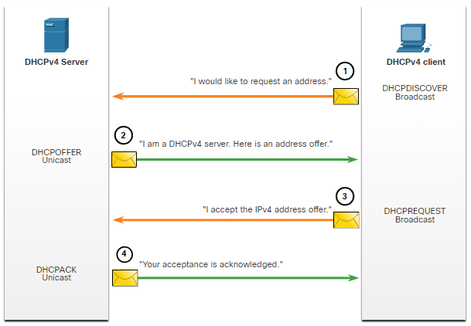
DHCP Operations

Slide 10
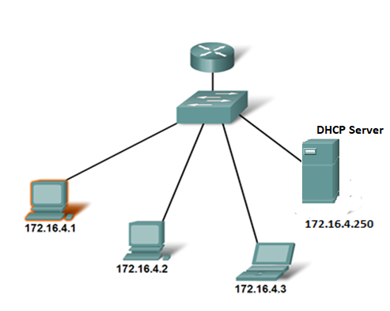


DHCP Operation - Start
DHCP Discover (Broadcast packet)
Finds the DHCP server(s) on the network.
172.16.4.254
Packet
Packet
Packet
Packet
Packet
Packet
Host A
Host B
Host C
FFFF-FFFF-FFFF | Host A | 255.255.255.255 | 0.0.0.0 | 67 | 68 | DATA
Dest MAC address | Source MAC address | Dest IP address | Source IP address | Dest Port No | Source Port No | DATA

Slide 11
DHCP Operation
DHCP Offer (Unicast)
Contains an available IP address to lease
Packet
IP address : 172.16.4.1 Subnet Mask: 255.255.255.0 Default Gateway: 172.16.4.254 DNS Server : 172.16.4.160 Lease Time : 3 days
Packet
Host A
Host B
Host C
Host A | DHCP Server | 172.16.4.1 | 172.16.4.250 | 68 | 67 | DATA
Dest MAC | Source MAC | Dest IP | Source IP | Dest Port | Source Port | DATA

Slide 12
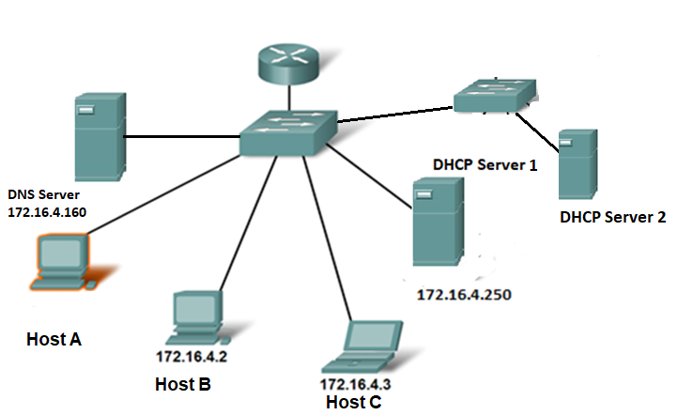
DHCP Operation
DHCP Request (Broadcast)
Tells server which address host has accepted
Packet
Packet
Packet
Packet
Packet
Packet
Packet
Did not take my IP address, so the address is free….
Packet
Took my IP address, so the address is occupied….
FFFFFFFFFFFF | Host A | 255.255.255.255 | 172.16.4.1 | 67 | 68 | DATA
Dest MAC | Source MAC | Dest IP | Source IP | Dest Port | Source Port | DATA

Slide 13
DHCP Operation
DHCP Acknowledgement (Unicast)
Server Gives the OK to host to use the IP address.
Packet
Packet
Host A | DHCP Server | 172.16.4.1 | 172.16.4.250 | 68 | 67 | DATA
Dest MAC | Source MAC | Dest IP | Source IP | Dest Port | Source Port | DATA

Slide 14
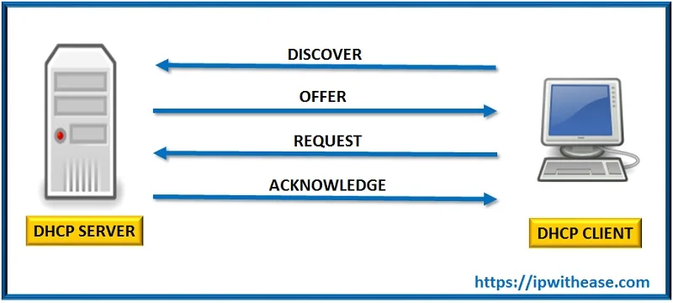
DHCP Operation (DORA)
IP address : 172.16.4.1 Subnet Mask: 255.255.255.0 Default Gateway: 172.16.4.254 DNS Server : 172.16.4.160 Lease Time : 3 days
Notes:
When the client boots (or otherwise wants to join a network), it begins a four-step process to obtain a IP address:

Slide 15
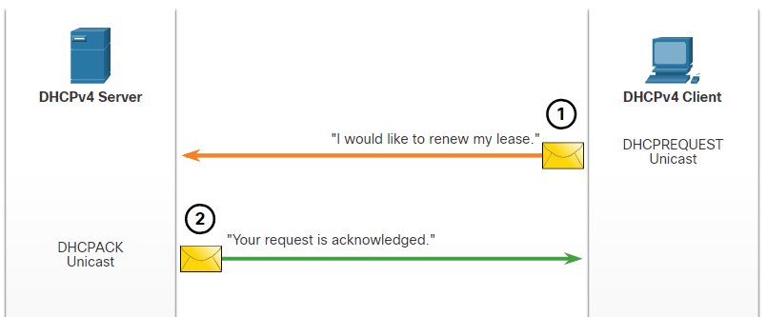
Steps to Renew a Lease

Slide 16

DHCP Operation
DHCP works in a client/server mode.
When the client connects, the server assigns or leases an IP address to the device.
The host must contact the DHCP server periodically to extend the lease.
The leasing of addresses assures that addresses that are no longer used are returned to the address pool for use by other devices.

Slide 17

DHCP RELAY

Slide 18
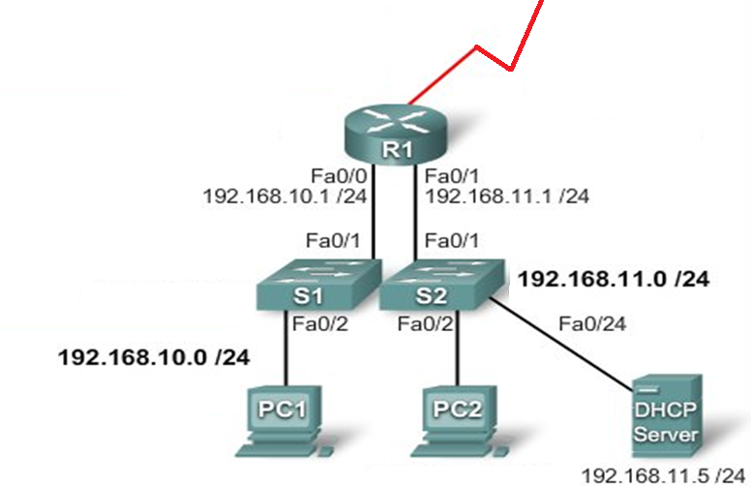
DHCP related issues
What is the problem here?

Slide 19
Problem with DHCP Server not in the same network
PC1 tries to obtain an IP configuration
Routers never forward broadcast packets!
Solution??
Broadcast

Slide 20
DHCP RELAY
How It Works:
Request: A client broadcasts a DHCP request on its local network.
Relay: A router/switch with DHCP relay enabled intercepts this broadcast.
Forward: The relay agent forwards the request via unicast to the central DHCP server.
Response: The server sends the IP offer back to the relay agent, which then sends it to the client

Slide 21

Dest MAC | Source MAC | Dest IP | Source IP | Dest Port | Source Port | DATA
FFFFFFFFFFFF | PC1 | 255.255.255.255 | 0.0.0.0 | 67 | 68 | DATA
DHCP Server
R1 Fa0/1 Mac
192.168.11.5
Known as
DHCP Relay
Configure R1 Fa0/0 (the interface that receives the PC1broadcasts) to relay DHCP broadcasts to the DHCP server, use the following commands:
R1(config)#interface fa0/0
R1(config-if)#ip helper-address 192.168.11.5

Slide 22
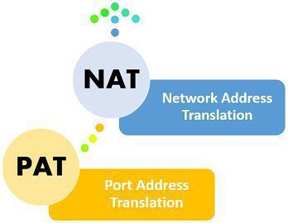

How many devices share one IP
address
Why do we need to share??

Slide 23
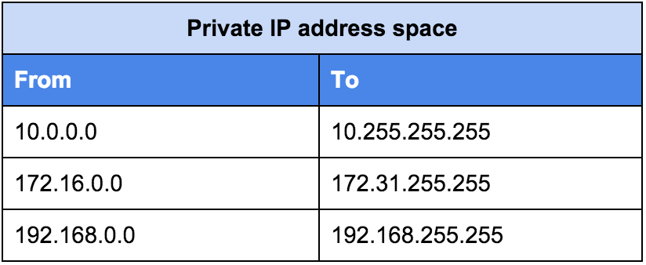
Category of IP Addresses
Two Categories
Private IP addresses
Public IP addresses
Private IP Addresses:
Used inside homes, offices, universities
Cannot be used on the internet
Safe and reusable
Assigned manually or via DHCP
Example : Separate three IP ranges
10.0.0.0/8
172.16.0.0/12
192.168.0.0/16

Slide 24

Category of IP Addresses
Public IP Addresses:
Used on the internet
Must be unique globally
Provided by ISP
Expensive and limited
Example : Any IP address not within the above private ranges can be considered a public IP address.

Slide 25
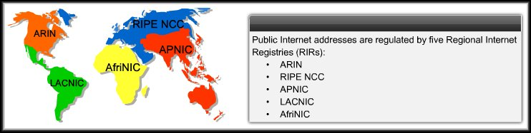
Public Addresses
Must be unique worldwide
Given by ISPs and regulated by global organizations called Regional Internet Registries (RIRs).
Organizations that owns the public IP can use it on their network.

Slide 26
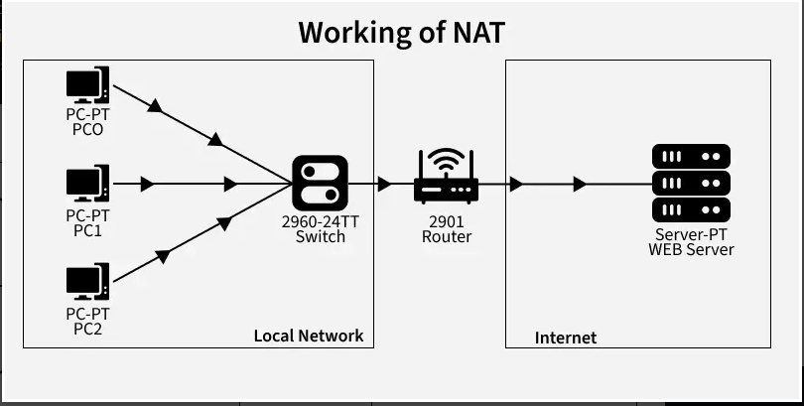
How NAT Works ?
A device sends a request, reaches the NAT enabled router.
Router replaces the private IP with its public IP and assigns a unique port.
NAT stores this mapping in the NAT table.
When the server responds, NAT uses the stored entry to send the packet to the correct internal device.

Slide 27
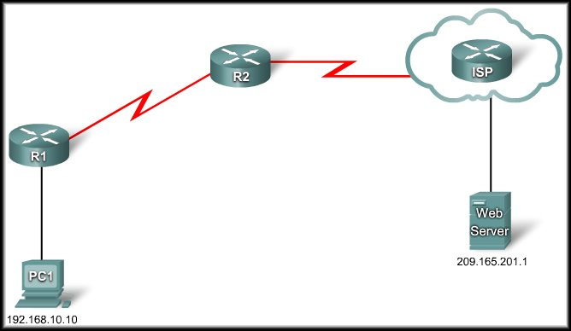
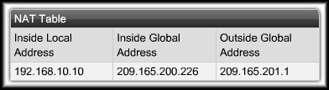
Example: NAT; Sending
R2: I have a packet for the outside network. I must translate the IP address.
209.165.200.226
DA | SA
209.165.201.1 | 209.165.200.226
DA | SA
209.165.201.1 | 192.168.10.10

Slide 28
Example: NAT; Receiving
R2: I have a packet for the inside network. I must translate the IP address.
DA | SA
192.168.10.10 | 209.165.201.1
209.165.200.226
DA | SA
209.165.200.226 | 209.165.201.1

Slide 29
Advantages of NAT
Helps save official IP addresses
Keeps internal network settings consistent, even when public IP configurations change.
keeps user and device IPs private from the outside internet, enhancing security.

Slide 30
Disadvantages of NAT
NAT increases delays.
End-to-end IPv4 traceability is lost.
Can cause problems for some protocols, such as Ipsec, VPN
Main issue: Does not scale
Notes:
NAT Increases Forwarding Delays: NAT adds a small delay because it needs to translate private IP addresses to a public one and vice versa, which takes some extra time.
End-to-End Addressing Is Lost: With NAT, the original source and destination IP addresses are modified, meaning the devices on each end don't see each other's true IP addresses. This affects direct communication.
End-to-End IPv4 Traceability Is Lost: It becomes difficult to trace the path or determine the source and destination of data packets across the internet because NAT modifies the IP addresses in transit.
NAT Complicates Tunneling Protocols: Protocols like IPsec, which secure internet communications, rely on knowing the IP addresses of the endpoints. NAT changes these addresses, which can break or complicate these security protocols.

Slide 31
PAT (NAT Overload)

Slide 32
NAT Overload (PAT)
Port Address Translation (PAT) = Real-world NAT
Allows many devices to share one public IP
Uses port numbers to differentiate the devices
Router keeps a table:
Private IP + Port → Public IP + New Port
Each connection becomes unique because of the port
PAT changes both the IP address and the port number.

Slide 33
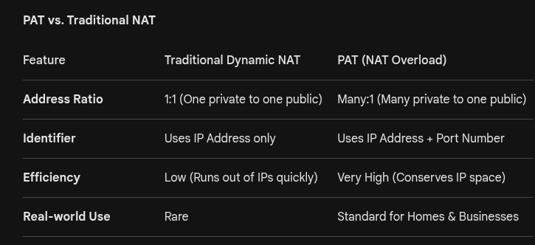
NAT Overload (PAT)

Slide 34
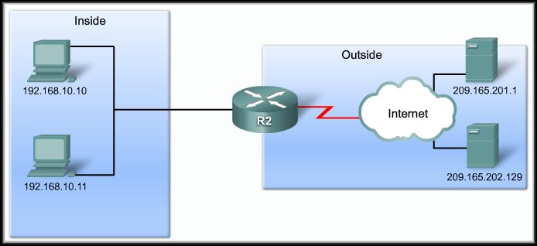
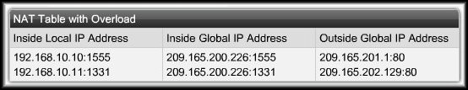
PAT Operation
209.165.200.226
SA | DA
192.168.10.10:1555 | 209.165.201.1:80
SA | DA
209.165.200.226:1555 | 209.165.201.1:80
SA | DA
209.165.200.226:1331 | 209.165.202.129:80
SA | DA
192.168.10.11:1331 | 209.165.202.129:80

Slide 35
PAT Operation
209.165.200.226
SA | DA
209.165.201.1:80 | 209.165.200.226:1555
SA | DA
209.165.201.1:80 | 192.168.10.10:1555
SA | DA
209.165.202.129:80 | 192.168.10.11:1331
SA | DA
209.165.202.129:80 | 209.165.200.226:1331

Slide 36
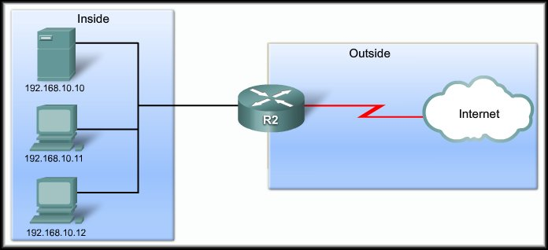

PAT Operation
NEXT AVAILABLE PORT NUMBER
192.168.10.11:1444
192.168.10.12:1444

Slide 37
Packets without Ports
Some protocols (like ICMP) do not have TCP/UDP port numbers
PAT still needs a way to identify each connection
ICMP uses a Query ID to match request reply
PAT uses this Query ID the same way it uses port numbers

Slide 38
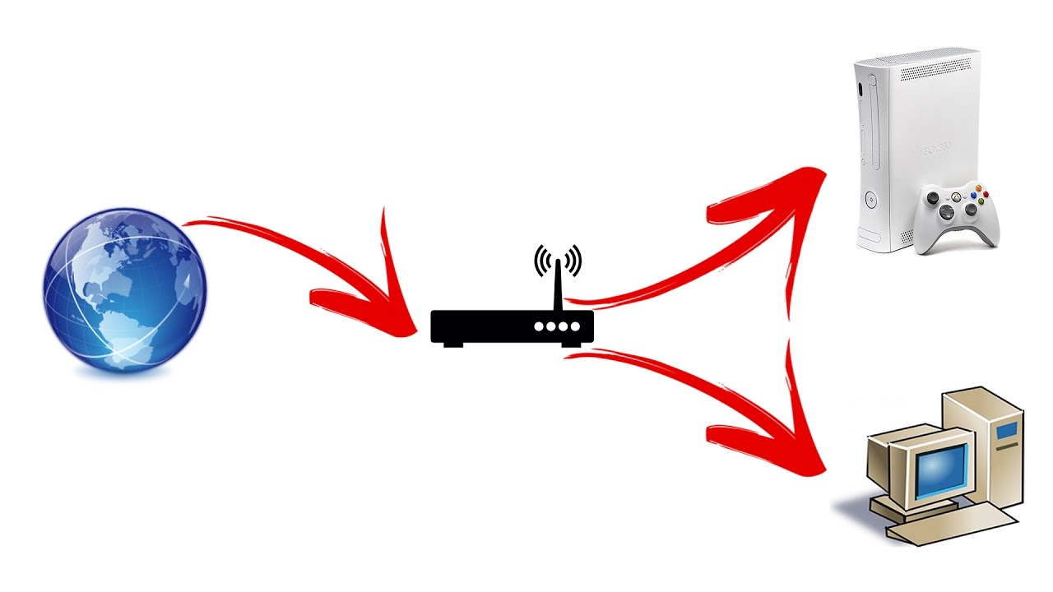
Port Forwarding

Slide 39
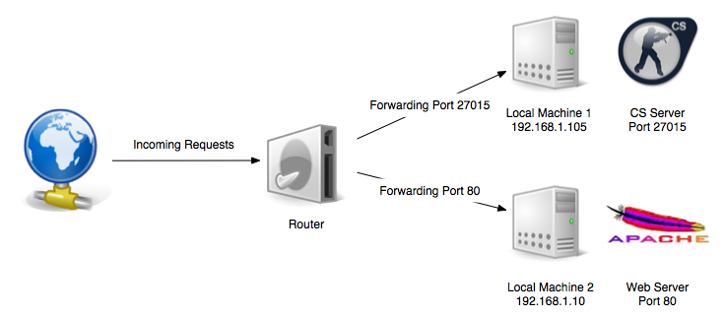
Port Forwarding
Sometimes we need access to services hosted on private IP addresses (like home security cameras or personal web servers) from the internet.
Can we do that?? Why? Why not?

Slide 40

Configure in Router : If Packet Dest IP 200.20.20.4 :80 => 192.168.10.10
www.software.com
www.software.com
192.168.10.10 : 80
200.20.20.4 : 80
Port Forwarding
One Public IP : 200.20.20.4
DNS Records for www.software.com => 200.20.20.4

Slide 41
Port Forwarding
Used when a server inside the network has a private IP
Router maps PublicIP:Port to the correct PrivateIP:Port inside the network.
Allows Internet users to access inside services

Slide 42
Port Forwarding
Access from outside
112.12.136.14 : 27105 ==> 192.168.1.105:27015
Public IP : 112.12.136.14

Slide 43
The End

